Slide 1
Maintaining Data Privacy in Association Rule Mining(MASK)
Data Protection & Privacy Course at UniGe
Supervisor : Alessio Merlo and Francesco Pagano
Presented by : Salah Yousef Mohamed Mokhtar Ismail, Amir Mashmool, Kozy-Korpesh Tolep
July 2023

Slide 2
Content
Introduction
Problem Framework
Quantifying MASK’s Privacy(distortion part)
Mining the Distorted Database(mining part)
MASK mining optimizations
Performance Framework
Experimental results
conclusion

Slide 3
Introduction
In data mining, the accuracy of the input data is very important for obtaining valuable mining results. However, in real life, there are many reasons which lead to inaccurate data.
One example is that, the users deliberately provide wrong information to protect their privacy. age, income, illness, etc.
Problem: how to protect user privacy while getting accurate mining results at the same time?
Privacy and accuracy are contradictory in nature.
A compromise way is more feasible. satisfactory (not 100%) privacy and satisfactory (not 100%) accuracy.
This paper studied this problem in the context of mining association rules.

Slide 4
Overview of the Paper
The authors proposed a scheme --- MASK (Mining Associations with Secrecy Konstraints).
The major idea of MASK
Apply a simple probabilistic distortion on the original data.
The distortion can be done at the user machine
The miner tries to find accurate mining results, given the following inputs:
The distorted data
A description of the distortion procedure
The performance of the scheme is validated using real and synthetic datasets.

Slide 5
Problem Framework
Each customer transaction is a record in the database.
A record is a fixed-length sequence of 1’s and 0’s.
E.g: for market-basket data
length of the record: the total number of items sold by the market.
1: the corresponding item was bought in the transaction, 0:non-purchase.
The database can be regarded as a two-dimensional boolean matrix.
The matrix is very sparse. Why not use item-lists?
The data will be distorted.
After the distortion, The distorted matrix will not as sparse as the true db.
Therefore,In this paper assume that the distorted db is stored as a large collection of bit-vectors
Database model

Slide 6
Problem Framework
The mining objective is to efficiently discover all frequent itemsets in the database, which correspond to statistically significant and strong association rules.
These rules have a support factor indicating their frequency and a confidence factor representing their strength. The goal is to find interesting rules that surpass user-defined thresholds for support and confidence.
A rule is said to be “interesting” if its support and confidence are greater than user-defined thresholds Sup _{min} and Con _{min} , respectively. example of a association rule: Transaction 1: {Bread, Milk} Transaction 2: {Bread, Milk, Diapers} Using these measures, we can discover association rules: Bread → Milk (Support: 40%, Confidence: 66.6%) This rule indicates that if a customer buys bread, they are likely to buy milk as well. Bread, Milk → Diapers (Support: 40%, Confidence: 50%) This rule states that if a customer buys both bread and milk, they are likely to buy diapers as well.
Mining Objectives

Slide 7
Problem Framework
the mechanism adopted in this paper for achieving privacy is to distort the user data before it is subject to the mining process.
As stated in the paper the metric is “with what probability can a given 1 or 0 in the true matrix be reconstructed”. It measures the probability of reconstructing distorted user data. It focuses on individual entries within customer tuples.
For many applications, customers may prioritize more privacy for their 1's (purchased actions) compared to their 0's (non-purchased options).
Privacy metric

Slide 8
Quantifying MASK’s Privacy (distortion part)
Distortion Procedure
Represent a customer record by a random vector.
Original record: X={X_{i}}, where X_{i} =0 or 1.
Distorted record: Y={Y_{i}}, whereY_{i} =0 or 1.
Y_{i} = Xi (with a probability of p)
Y_{i} = 1-X_{i} (with a probability of 1-p)
We generate the distorted vector from this customer tuple by computing
Y=distort(X) where Y_{i}=X_{i} XOR r_{i}(rbar i) and r bar i is the complement of r_{i} a
random variable with a density function F(r)=bernoulli(p) (0 <= P <= 1) That is,
r_{i} takes a value 1 with probability p and 0 with probability 1-p

Slide 9
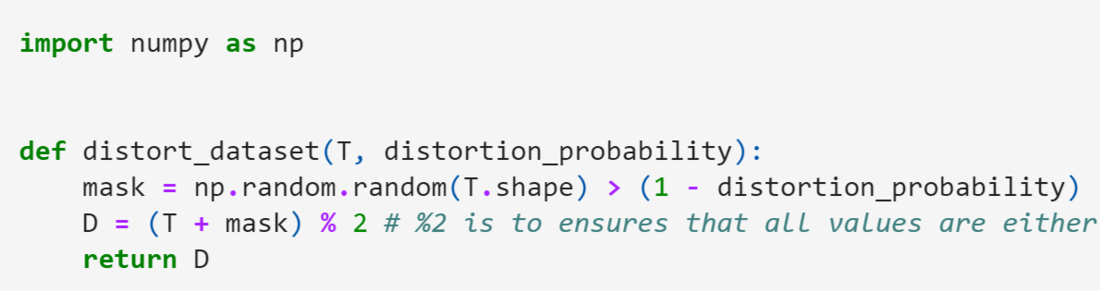
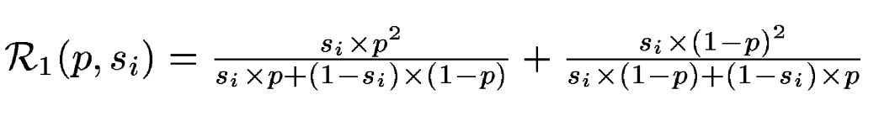
Quantifying Privacy
Calculate reconstruction probability
- Let S_{i} = prob (a random customer C bought the ith item) = the true support of item i
The probability of correctly reconstruction of a ‘1’ in a random item i is:

Slide 10
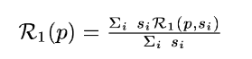
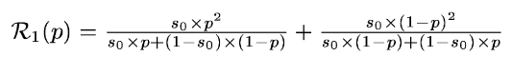
Reconstruction Probability
Reconstruction probability of a ‘1’ across all items:
Suppose
S₀=the average support of an item
Replace si by S₀, we get

Slide 11
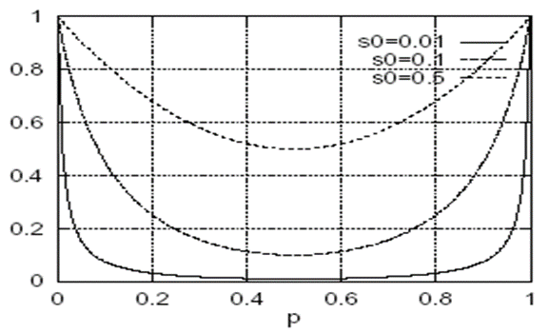
Reconstruction Probability
Relationship between R₁(p) and P, S₀
We can plot R₁(p) as a function of p for different value of S₀
Observations:
R₁(p) is high when p is near 0 and 1, and it is lowest when p=0.5.
The curves become flatter as S₀ decreases.

Slide 12
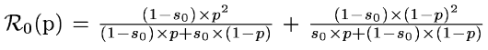
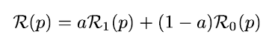
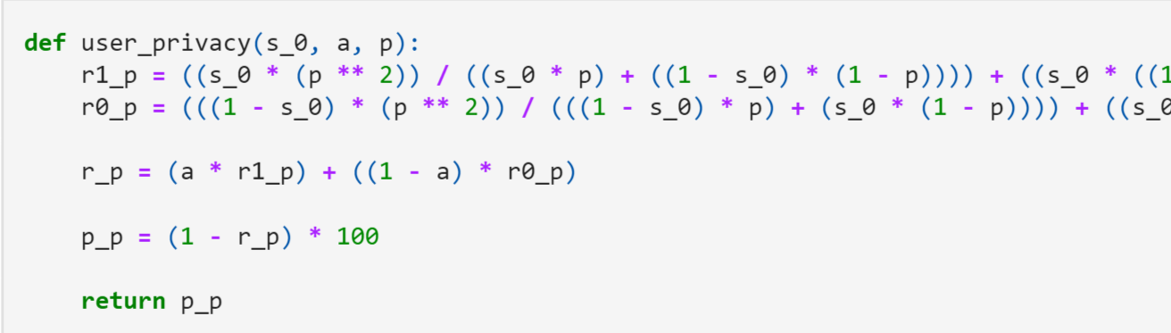
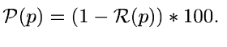
Privacy Measure
The reconstruction probability of a ‘0’
The total reconstruction probability
a is the weight parameter.
Privacy

Slide 13
MASK --- mining part

Slide 14
MASK --- Mining Part
How to estimate the accurate supports of itemsets from a distorted database?
Estimating 1-itemset supports
Estimating n-itemset supports
The whole mining process

Slide 15
How to estimate the accurate supports of itemsets from a distorted database?
C^{T}= M⁻¹ C^{D}
Distorted data
Real data
Probabilistic distortion
MASK
p

Slide 16
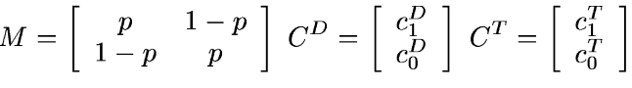
Estimating 1-itemset Supports
C^{T}= M⁻¹ C^{D}
Symbols:
T: the original true matrix; D: the distorted matrix;
i: a random item;
C₁^{T} and C₀^{T}: the number of 1’s and 0’s in the i column of T;
C₁^{D} and C₀^{D} : the number of 1’s and 0’s in the i column of D.
Note: p!=0.5

Slide 17
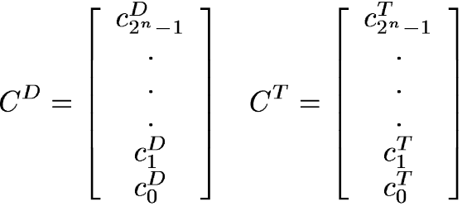
Estimating n-itemset Supports
C^{T} = M⁻¹ C^{D} to estimate support.
General case:
C_{K}^{T} is the number of records in T that have the binary form of k for the given itemset. That is, for a 2 -itemset, refers to the count of 10's in the columns of corresponding to that itemset
M _{i,j}= Prob ( C_{j}^{T} -> C_{i}^{D}).
M _{1,2}= (1-p)(1-p) (C₂^{T} -> C₁^{D} or C₁₀^{T} -> C₀₁^{D})

Slide 18
Full Mining Process
To calculate C_{i}^{D} , implementation of MASK was proposed
Based on Apriori algorithm
Difference:
E.g: when counting supports of 2-itemsets,
Apriori only need to count the No. of records that have value ‘1’ for both items, or of form “11”.
MASK has to keep track of all 4 combinations: 00,01,10 and 11 for the corresponding items.
Equation to compute the true supports needs to be evaluated at the end of pass
If the same value for p is used, the matrix M is identical for all candidate n-itemsets. O(M) = 2^{n}

Slide 19
MASK mining optimizations

Slide 20
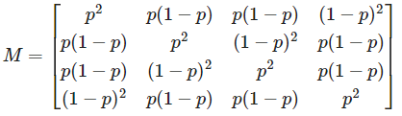
MASK mining optimizations
Linear Number of Counters
First, we need to focus on reducing number of counters. As it can be quite compute-intensive to find square matrix
for each itemset. If we closely look on how true support is calculated, we can find some ways for optimization. M matrix is inverted and multiplied to all combination of the n-itemset. As a result, reconstructed support is the weighted sum of the counts of different combinations of 2^{n} componentes of the distorted database. However, we can denote that there are only n+1 distinct weights for 2^{n} weights.

Slide 21
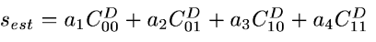
Linear Number of Counters
For instance, for a 2-itemset estimated reconstructed support can be found by formula:
Here, weights of a₂ and a₃ are equal because probability that ‘11’ distorts to ‘10’ is equal to the probability that ‘11’ distorts to ‘01’ both are equal to p(1-p).
Optimized calculation of M from: O(2^{n}) to O(n+1)

Slide 22
MASK mining optimizations
Reducing Amount of Counting
We can also make reduction in amount of counting with help of simple algebraic properties. Based on the fact that
C₀₀+C₀₁+C₁₀+C₁₁ = cardinality of db
we can choose not to count one of these components. Counting of only ‘11’ in the 2-itemset will take O(Tlen²) operations, where tlen is the transaction length. It can be reduced using following technique. Initially, for a item-list, we need to keep track of all identifiers that have 1's in the transaction, from this list we remove all singleton itemset identifiers that were calculated in the previous pass. The next stage is to create complement-list, which consists of previously estimated all frequent 1-itemsets that do not appear in the current transaction. Let the item-list and complement-list be of length M₁and M₂ so |M₁+M₂| =F₁ Where F₁ is total number of frequent 1-itemsets. If we now, use this technique to calculate 11's, 01's and 10's, it will take O(m₁²)+O(m₁+m₂) operations.

Slide 23
Performance
Based on our implementation

Slide 24
Errors
The estimated support values from mask are not expected to match the actual support value from apriori but it is expected to have some error.
This error can lead to huge impact leads to wrongly classify border-line itemsets as either frequent or rare ( false positive or false negative) errors.
False positive : itemsets wrongly reported as frequent
False negative : itemsets wrongly reported as rare
We prioritize coverage over precision so we consider 10 % reduction in minimum support value, this means lowering the thresholds for what is considered interesting or frequent itemsets. This allows more items to be included but also may leads to more False positives

Slide 25
Calculate Errors
To quantify the error made we compare
Estimated support of frequent itemsets From Mask running on distorted dataset
Actual support of frequent itemsets From Apriori running on true dataset
with
This means we compute the Support error and Identity error to measure the performance of the MASK algorithm.

Slide 26
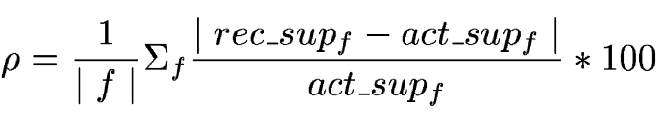
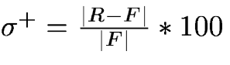
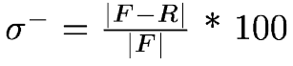
Performance
Error Metrics
Right class, wrong support
Infrequent itemsets, error doesn’t matter
Frequent itemsets
Support Error:
Wrong class
Identity Error:
false positives:
false negatives:

Slide 27
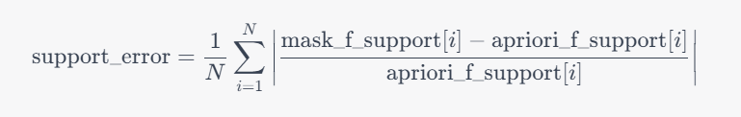
Performance
Error Metrics
Support Error calculate_support_error() method
In this equation, N represents the total number of frequent itemsets.
mask_f_support of i refers to the estimated support of the i-th frequent itemset obtained from MASK, and
apriori_f_support of i represents the actual support of the i-th frequent itemset from Apriori.
The equation calculates the absolute difference between the estimated support and actual support of each frequent itemset, divides it by the actual support.
takes the average of these relative errors over all itemsets to compute the support error metric.

Slide 28
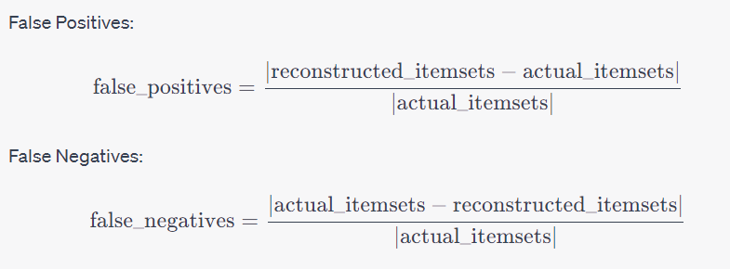
Performance
Error Metrics
Identity Error calculate_identity_error() method
In these equations, abs () denotes the cardinality (number of elements) of a set.
The numerator represents the set difference between the reconstructed itemsets and the actual itemsets,
The denominator represents the cardinality of the actual itemsets.
The division is performed to normalize the errors and express them as proportions.

Slide 29
Performance
Different levels
We calculates the support error and identity error metrics for different levels of itemsets obtained from the MASK algorithm compared to the Apriori algorithm.
By Breaks down the calculation of support error and identity error metrics into levels based on the length of itemsets.
Then calculates these metrics for each level separately, storing the results in lists for further analysis or visualization.
Apriori returns different data structure from ours so we made utility method to convert the shape of the output to me identical to be able to compare.

Slide 30
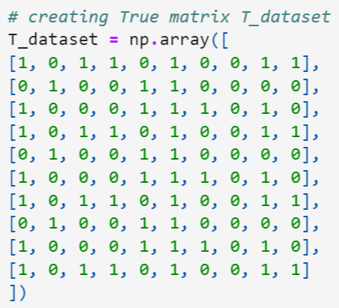
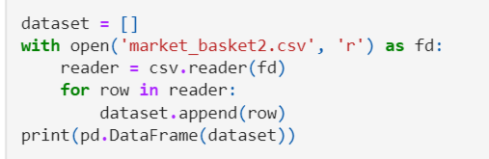
Experimental results
Data sets
Synthetic database
10 records; 10 items
S₀=0.01
Real dataset
1000 records; 10 items
S₀=0.01

Slide 31
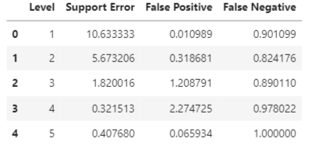
Experimental results
Synthetic dataset performance table

Slide 32
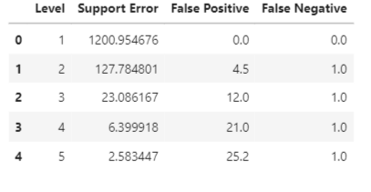
Experimental results
Real database performance table

Slide 33
Summary
Good privacy and good accuracy can be achieved at the same time by careful selection of p.
In our experiments, p around 0.7 is the best choice.
A smaller p leads to much accuracy error in mining results.
A larger p will reduces the privacy greatly.

Slide 34
Conclusion
This paper studies the problem of achieving a satisfactory privacy and accuracy simultaneously for association rule mining.
A probabilistic distortion of the true data is proposed.
Privacy is measured by a formula, which is a function of p and S₀
A mining process is about to estimate the real support from the distorted database.
Experiment results of the our implementation of the paper show that there is a small window of p (near 0.7) that can achieve good privacy (81%+)

Slide 35
Thank you

